Slide 1
Theoretical Constructs of Professional Identity and their Meanings for Physiotherapy
Dr Hazel Horobin
images are referenced, from creative commons or are my own pictures, full references are attached where they occur in the slides

Slide 2
Presentation outline:
Outline my own professional identity and the shaping forces I’ve experienced
Briefly present contemporary theoretical approaches to understanding and researching identity
Use these constructs to explore issues in professional education

Slide 3
Why am I interested in identity?
Learning = identity formation
Learning is a process of ‘becoming’, with who we are being represented by our identities (Dall’Alba and Barnacle, 2007) … and because I am aware of my own identity journey
Dall’Alba, G., & Barnacle, R. (2007). An ontological turn for higher education, Studies in Higher Education, 32(6), 679-691.

Slide 4
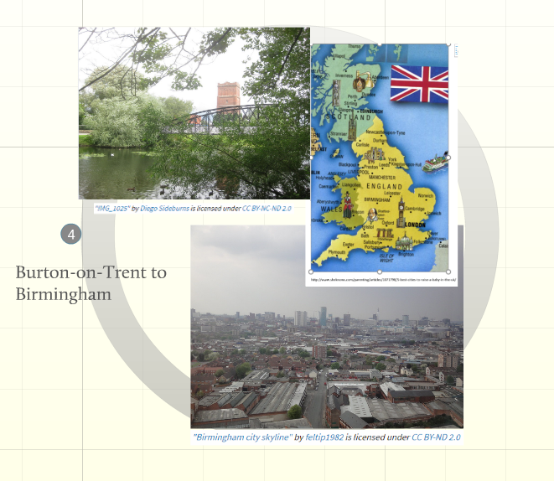

Slide 5
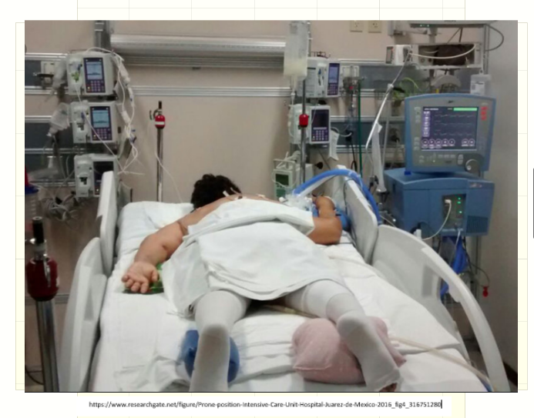

Slide 6
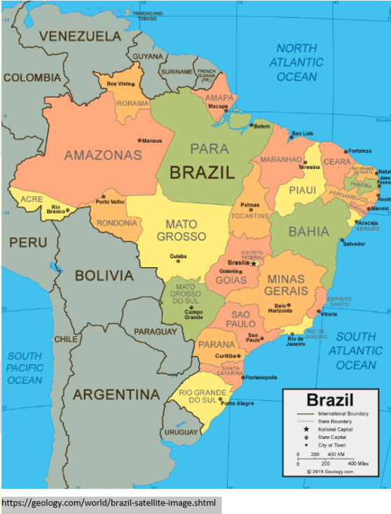

Slide 7
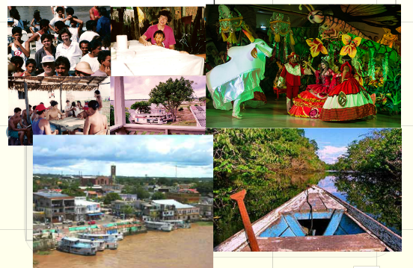

Slide 9
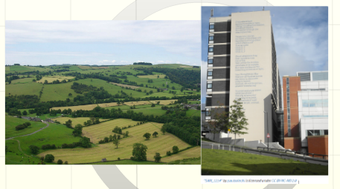

Slide 10
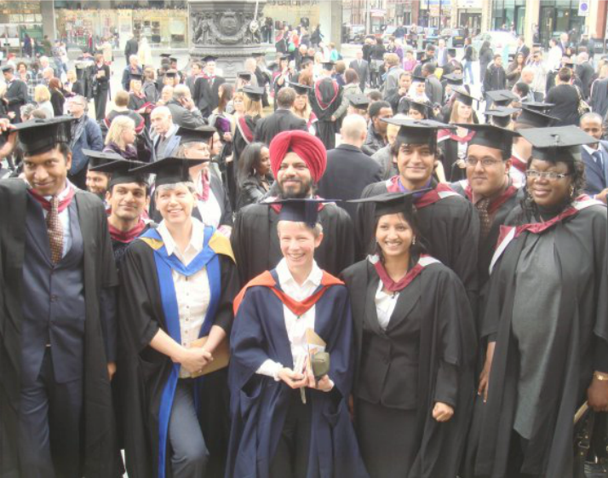

Slide 12
What is identity? It is social and negotiated
Jenkins (2004) suggests that individual identities also are 'social' as always and everywhere we share aspects of our identity - this can be thought of as 'culture' but...
We have different identities in different times with different people and in different places - despite a strong sense of personal consistency (Jenkins , 2004) so...
If personal identity is something difficult to define, what does this mean for a group identity?
Identifying ourselves is a matter of making meaning, and this involves interaction, (dis)agreement, convention, innovation, communication and negotiation and this is true for our identity as physiotherapists.
Jenkins, R. (2014). Social identity. Routledge. London.

Slide 13
What is identity? It is ongoing…
Given that identity is fluid and social, the interactions with others form our identities and can be understood as a process of ‘being’ or ‘becoming’. It is never a final or settled construction. Learning can be seen then to shape the construction of ourselves. Social construction of identity occurs both in individual interaction as well as structurally - the bringing together of ‘public issues’ and ‘private troubles’ (Mills et al. 1959: 8)
Mills, J., Benner, A. & Francis, K. (2008). The development of constructivist grounded theory. International Journal of Qualitative Methods, 5(1), 25-35

Slide 14
If the self is made, what form does it take?
Identity is a continual project, we create, maintain and revise a set of biographical narratives – the story of who we are, how we came to be where we are now. Our identity stories are out reflexive understanding of our biography.
But these narratives cannot be wholly internal though, as we must continually integrate events in the external world and sort them into the ongoing story about the self (Gauntlett, 2008).
Gauntlett. D. (2008) Media, gender and identity: An introduction. Routledge. London.

Slide 15
Foucault and the self – structure vs. agency
Personality is not fixed, it is always in flux, and may not exist at all in any realistic sense.
Society and its power constraints, rules and regulations, as well as other contrasting and complimentary factors all gel into forming ‘technologies of the self’. Our portrayal of these facets from within, projected towards society and from outside projected within ourselves, determines who we are to ourselves and to other people (Foucault, 1988).
Foucault, M. (1988). Technologies of the self. A seminar with Michel Foucault, Univ. of Massachusetts Press. Massachusetts.

Slide 16
Identity or Identification?
Is not reducible to a single logic such as class or gender (Rutherford, 1990).
Combining elements into a third term has been called ‘articulation’ – Gramsci (Jones, 2007) described this as the starting point of critical elaboration. Identification is understandable in the context of history, with the intersection of our everyday lives as well as with the economic and political relations of subordination and power.
Jones, S. (2007). Antonio Gramsci. Routledge. London.
Rutherford, J. (1990). A place called home: Identity and the culture of difference. In Identity: Community, culture, difference. Ed. J. Rutherford. 9-27. Lawrence and Wishart: London.

Slide 17
So, what is identification? A meta-concept
Defined as the ways in which individuals and collectives are distinguished in their social relations with other individuals and collectives (Babad et al, 1983).
Latin root ‘idem’ – the same; two basic meanings similarity and difference.
Identification is about a sense of personal location and social relationships – vast potential of possible (potentially contradictory) belongings (Weeks, 1990).
Babad, E. Y., Bormbai, M. & Benne, K. D. (1983). The social self: Group influences on personal identity: Sage: Thousand Oaks, CA.
Weeks, J. (1990). The value of difference. In Identity: Community, culture, difference. Ed. J. Rutherford. 9-27. Lawrence and Wishart: London.

Slide 18
Habitus?
Improvisations are the sort of spontaneous acts that occur when our past, brought to the present as habitus, meets with a unique blend of circumstances and for which we do not have an established response. Bourdieu (1977) calls this the art of living.
Condensed, ‘improvisations from a cultural base and in response to the subject positions offered in situ are, when taken up as a symbol, potential, potential beginnings of an altered subjectivity, altered identity’ (Holland, 1998; 18)
Bourdieu, P. (1977). Outline of a theory of Practice (Vol. 16): Cambridge University Press, Cambridge.
Holland, D. C., Lachicotte, W. J., Skinner, D. & Cain, C. (2001). Identity and agency in cultural worlds. Harvard University Press, Cambridge, Massachusetts.

Slide 19
How to view issues of structure and agency conceptually?
Divide within sociology between macro and micro levels e.g. Durkheim and WeberHuman agency and social structure are in a relationship with each other – traditions, institutions, moral codes and established ways of doing things, but these can be changed when people ignore, replace or reproduce them differently, particularly when culture is challenged (e.g. when the woman climbed the house – Holland et al. [1998])

Slide 21
Identification and modernity
Gauntlett (2008) puts Giddens at the centre of the emergence of identity who suggests that, when tradition dominates, we don’t think about our actions much
‘What to do? How to act? Who to be? These are focal questions for everyone living in circumstances of late modernity and ones which, on some level or another, all of us answer, either discursively or through day to day social behaviour (Giddens 2013: 70)
Gauntlett. D. (2008) Media, gender and identity: An introduction. Routledge. London.
Giddens, A. (2013). Modernity and self-identity. Self and society in the late modern age. John Wiley and Sons: New Jersey.

Slide 22
What does this mean to physiotherapy and physiotherapy education if professional identity?
What aspects and issues make up our/my/your identity? And
If identity is:
social and structural and in constant flux....
Is 'contained' and historically framed...
Is worked, created, agreed and disagreed upon, there are tensions about what it is to be a physiotherapist and these have to be answered in practice...
Combines convention and innovation...
Relies upon the narratives we have for ourselves....
Expresses power relations with others......
Then what do these issues mean for preparing people to join the profession?

Slide 23
What is the impact of education?

