Slide 1
Complexity and pain
Jenny Setchell
Research Fellow
School of Health and Rehab Sciences
University of QLD
Brisbane
Australia
Dave Nicholls
Associate Professor
School of Clinical Sciences
AUT University
Auckland
New Zealand
Notes:
intro

Slide 2
How is pain complex?
Notes:
ask for some examples – Jenny
Dave scribe

Slide 3
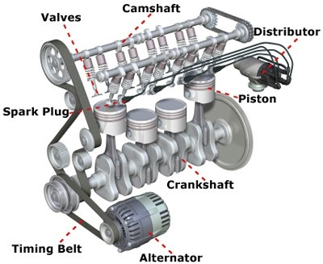
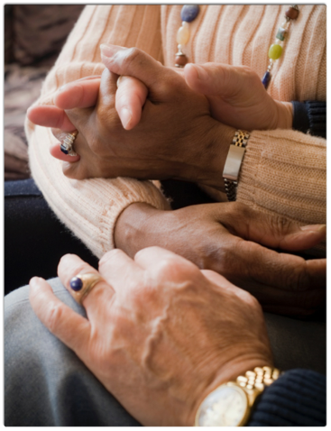
People in pain are complex, not complicated
‘There is complexity if things relate but don’t add up, if events occur but not within the processes of linear time, and if phenomena share a space but cannot be mapped in terms of a single set of three-dimensional coordinates’
- Mol and Law (2006)
Complicated
Complex
Notes:
Complicated
is one that can be understood by analysing the interaction of its component parts (reductionism)
how many examples of complicated systems can you name (some help to get you started…car engine)?
Complex
is one that cannot
‘Complexity arises from the interaction between the components of a system and the interaction between the system and the environment’ (Hassey, 2002, p.63)
how many examples of complex systems can you name (e.g. therapy)?

Slide 4
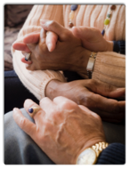
Difference between complicated and complex systems in physiotherapy
Anatomy, physiology
EBP
Signs
ICF
Cure
Psychology
Exams
Communication
Touch
Symptoms
Pain
Care
Relationships
Passing

Slide 5
UNDECIDABILITY, Unpredictability & ambiguity
Knowledge is always partial
Always ambiguity
Creates tension:
Bad – Anxiety
Good – Desire
Science dislikes uncertainty
Tries to know/command patient
People seen as complex systems
BUT
People are innately complex
Cannot be fully known
Each person unique
Unique world view / lived world
Subjectivity defies mastery
Cannot be compartmentalized
Exemplified by pain
Notes:
People’s knowledge will always be partial
Which means that there will always be uncertainty/ambiguity
Ambiguity creates tension - some bad (we’re anxious that we don’t know enough), some good (we search for answers)
Western science is based on the belief that the world is ‘external’ to us and can be ‘known’ (studied, observed, understood)
Science is intolerant of ambiguity and tries to eliminate it - replacing uncertainty with facts
We use science to study the world, and thereby dominate nature
Medical science considers patients as data in the same way as biologists, chemists and physicists study atoms, trees and the cosmos
Scepticism of medical science is directed at this logic…are people just complicated biological systems or are they more complex than this?

Slide 6
3 features of complex problems
Unpredictability | requires constant vigilance can only be understood after the fact cannot be anticipated
Uncertainty | creative tension anxiety pre-acceleration (see later)
Unreproducibility | cannot explain with quantitative logic

Slide 7
Counterintuitive in Western context
The entirety of the world cannot be known
There are always limits on our practical knowledge
This allows for different world views - different existences - different people
The essence of our humanity is based on our essential difference from one another
We are humans, not machines
Unpredictability and uncertainty are necessary and desirable

Slide 8
Complexity case study: Pre-acceleration

Slide 9
Activity 1:
A new patient comes to see you to discuss their persistent low back pain. This person has seen many different health professionals. One of the patient’s main concerns is that, despite being offered many different reasons for her pain, she is not satisfied with these as a cause of her pain.
Unpredictability | requires constant vigilance can only be understood after the fact cannot be anticipated
Uncertainty | creative tension anxiety pre-acceleration (see later)
Unreproducibility | cannot explain with quantitative logic
Notes:
Either in small groups or to the group as one – to decide on the day. Animate in the table as a prompt if needed.
Questions might include:
How might physiotherapy traditionally approach this situation? (as a complicated problem)
In what ways might this physiotherapy encounter be understood as complex?
What if the patient already understands biopsychosocial theories of pain – how might complexity add help you re-think your approach?
In what ways might an understanding of complexity open up new options for your understanding of your role in this situation?
In what ways might an understanding of complexity be relevant to this patient?
What practical strategies might you discuss in collaboration with your patient as options for integrating an understanding of complexity in this instance.

Slide 10
Activity 2
The patient has a BMI of 32 (ie is classifed as obese).
Notes:
Intersections… See what happens when numbers come up … are assumptions are made? A BMI of 32 could be a fit rugby player, person might already be exercising, people might not want to address weight at the moment but focus on other things in their life/in their physiotherapy session.
Animate in the pictures following discussion in groups/individual (to be decided on the day).
Questions might include:
What might be a traditional physiotherapy approach here? (as a complicated problem)
In what other ways might this physiotherapy encounter now be understood as complex?
In what ways might an understanding of complexity open up new options for your understanding of your role in this situation? Subjectivity etc.
In what ways might an understanding of complexity be relevant to this patient?
What practical strategies might you collaboratively discuss with your patient as options for integrating an understanding of complexity in this instance.
Refer to earlier points: People are innately complex, Cannot be fully known, Each person unique, Unique world view / lived world, Subjectivity defies mastery, Cannot be compartmentalized

Slide 11
Future of physiotherapy is in complex ideas
Acute/cure in decline
Ageing population
Long-term illness
Changing economy of HC
Skepticism of biomedicine
Openness to CAMs
Growing techno-science
Embodiment
Pain management is a paradigm example of the challenge of future health care

Slide 12
What do you do to close? What opens?
Critical Forum: Tuesday 10.30-12.30am
Notes:
Questions?
Close – CPN and forum plug

